Slide 1








FLIGHT MANAGEMENT SYSTEM

Slide 2







INFOSYS SPRINGBOARD
Presented By:
Pushkar Lunawat
Raman
Suchitra Shaw
Navneet Chadhokar
Guided By: Sanjeev Gone

Slide 3




Abstract
In conclusion, the Flight Management System provides a comprehensive Java-based solution for booking and managing flight tickets. By integrating data from various airline carriers, it offers real-time updates on flight details and rates, enhancing the user experience. Passengers benefit from the flexibility to book, cancel, view, and update their reservations effortlessly. Additionally, the system simplifies administrative tasks, allowing for efficient management of bookings, flights, schedules, and routes within a single platform. This robust application streamlines both user and administrative processes, making flight management more efficient and user-friendly.

Slide 4



User Operations:
Register User
Login User
View Available Flights
Book Flights
Modify / Cancel Bookings
Modify Passenger Details

Slide 5






Admin Operations:
Login Admin
Manage Flights
Manage Airports
Manage Flight Schedules
Manage Users

Slide 6
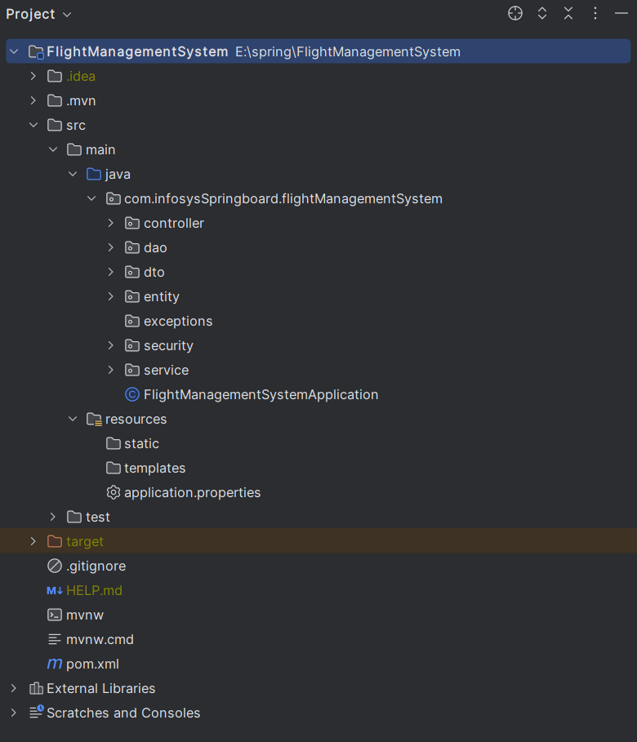
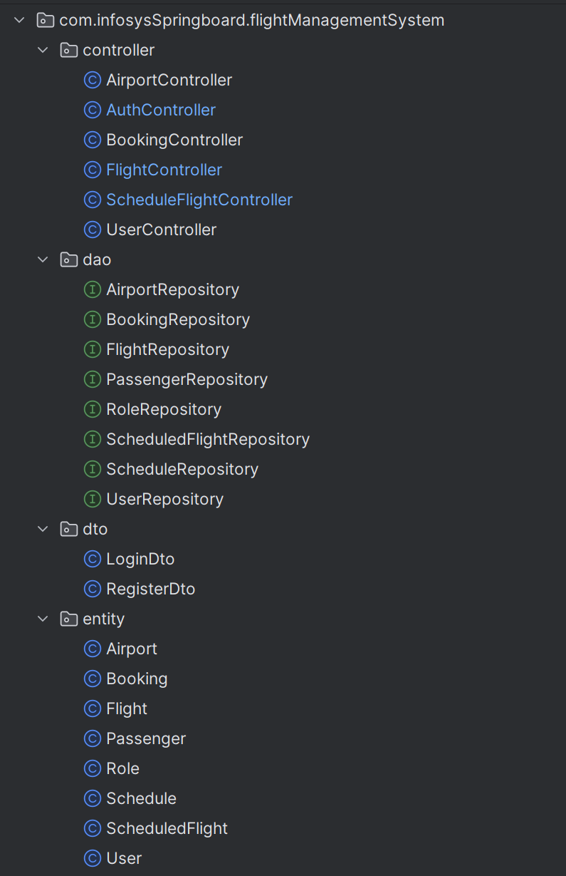
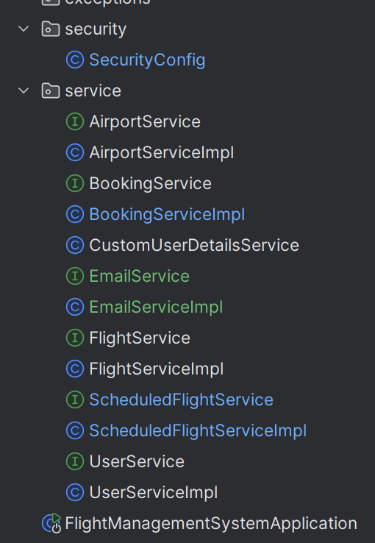
Project Structure

Slide 7
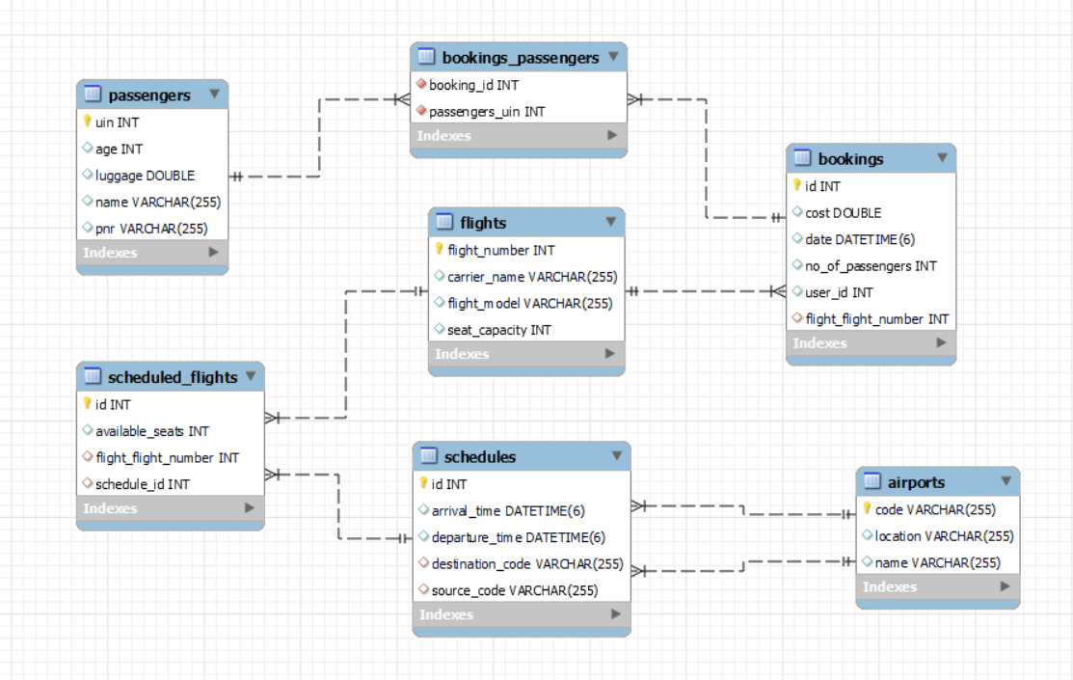
Entity Structure

Slide 8
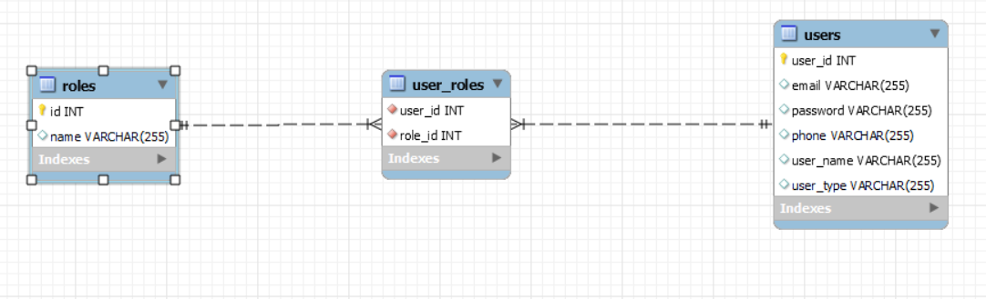
User and Roles Structure

Slide 9
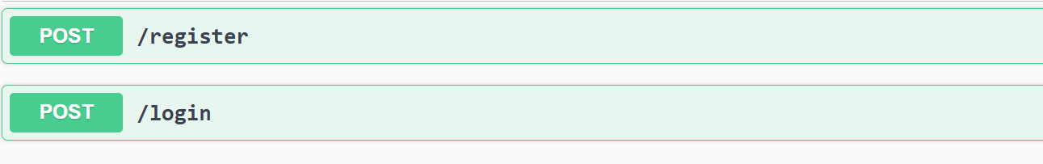
Registration
Register User
Login User

Slide 10
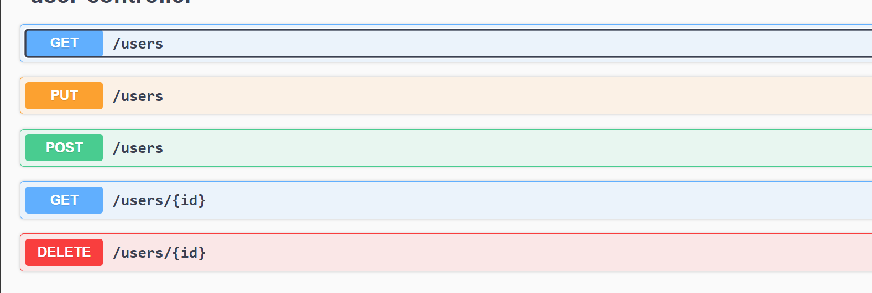
User operations
Get All User
Update User
Add new User
Get User By id
Delete User

Slide 11
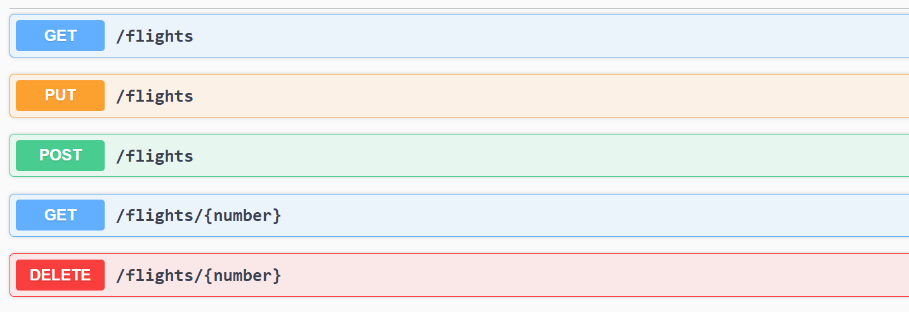
Flight operations
Get All Flights
Update flight
Add new Flight
Get flight By id
Delete flight by id

Slide 12
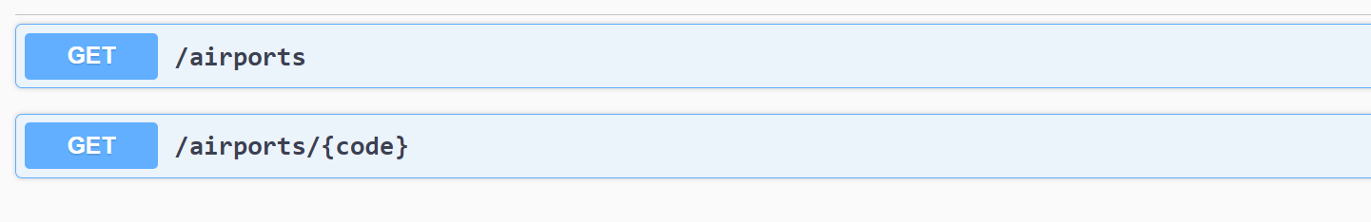
Airport operations Note :- Airports are Already set in database
Get All Airports
Get Airport by code

Slide 13
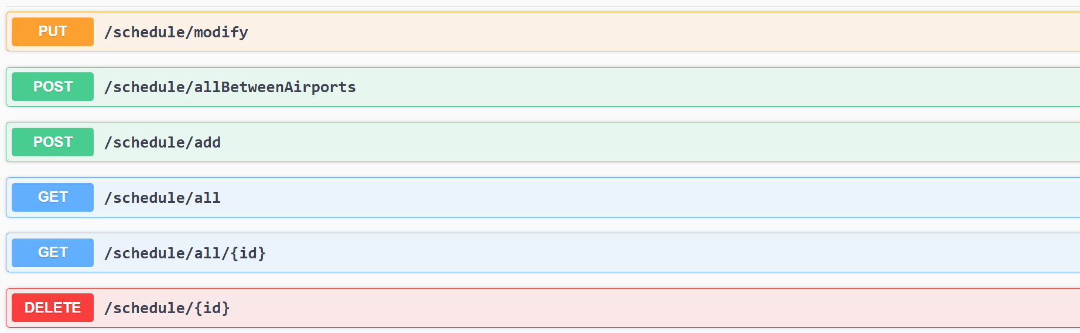
Scheduling operations
Modify Schedule
Getting flights between Airports
Add new Schedule
Get All Schedule
Get Schedule By Id
Delete Schedule by Id

Slide 14
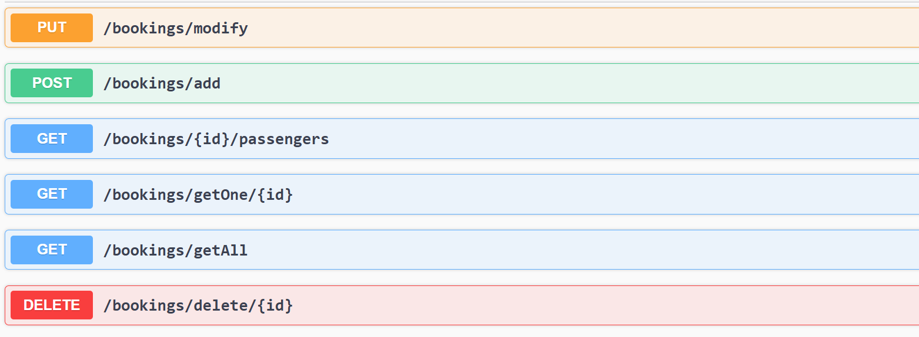
Booking operations
Modify Booking
Make A booking
Get all passengers in a booking
Get A Booking
Get All Booking by A User
Delete Booking by Id

Slide 15







Software Used:
IntelliJ
Postman
MySQL Workbench

Slide 16



Backend
Java
Spring Boot
Hibernate
MySQL

Slide 17





Rest API Docs
http://localhost:8080/swagger-ui/index.html

Slide 18
GitHub Link
https://github.com/rmnjaat/InfosysFlightManagemetProject

Slide 19
Conclusion
It has been a great pleasure for our team to work on this exciting and challenging project.
This project provided us practical knowledge of not only programming in Java and Spring boot .
It also provided knowledge about the latest technology used in developing web enabled application and client server technology that will be great demand in future.
This will provide better opportunities and guidance in future in developing projects independently.

Slide 20



Thank You

